Slide 1

The FIFA World Cup: A Global Phenomenon
The FIFA World Cup is the most prestigious international soccer tournament, held every four years. It brings together multiple national teams to compete for soccer's ultimate prize.
By Sanket Khamkar & Shrey Shah

Slide 2
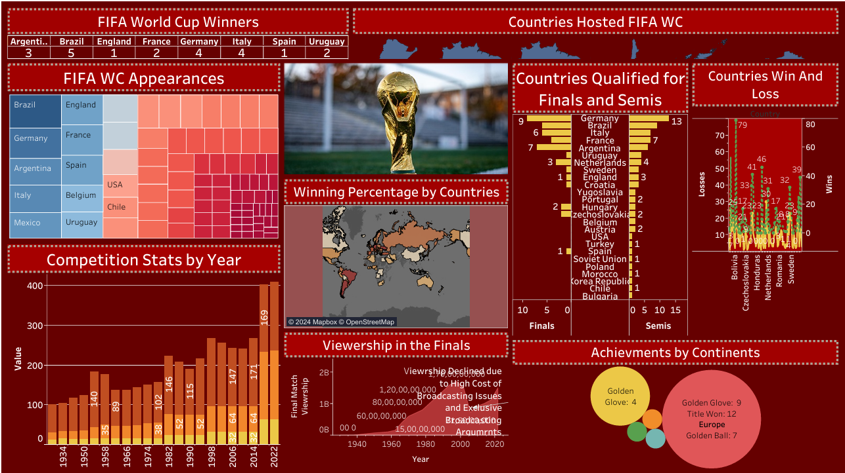

Slide 3
Dataset Processing and Data Cleaning Performed
Data set:
Data set is taken from Kaggle and Official FIFA website
Data Cleaning Performed:
Removed 16 duplicate rows. Filled or removed 119 null values in columns with missing data. World Cup - Tableau format
Minimal cleaning required. WC STATS COUNTRIES
Differentiated old country names and their stats. Like Dutch East Indies country used to be exist but now its name is Indonesia . Same for East and West Germany.
Standardized column names: Renamed columns to maintain consistent naming conventions (e.g., Year, Home Team Goals).
Corrected data types: Converted date columns to datetime format for accuracy.
Fixed formatting issues: Standardized team names and text fields for consistency (e.g., "Germany FR" -> "Germany").
Adjusted data types: Converted numeric columns to the appropriate integer or float types.

Slide 4

Introduction to FIFA
FIFA's Full Name
Tournament Frequency
International Federation of Association Football
Held every four years
Global Reach
Qualification Process
Involves six FIFA continental zones
Starts almost three years before the final tournament

Slide 5

Involves six FIFA continental zones
Africa: Represented by CAF (Confederation of African Football)
Asia: Represented by AFC (Asian Football Confederation)
Europe: Represented by UEFA (Union of European Football Associations)
North and Central America and the Caribbean: Represented by CONCACAF South America: Represented by CONMEBOL
Oceania: Represented by OFC

Slide 6
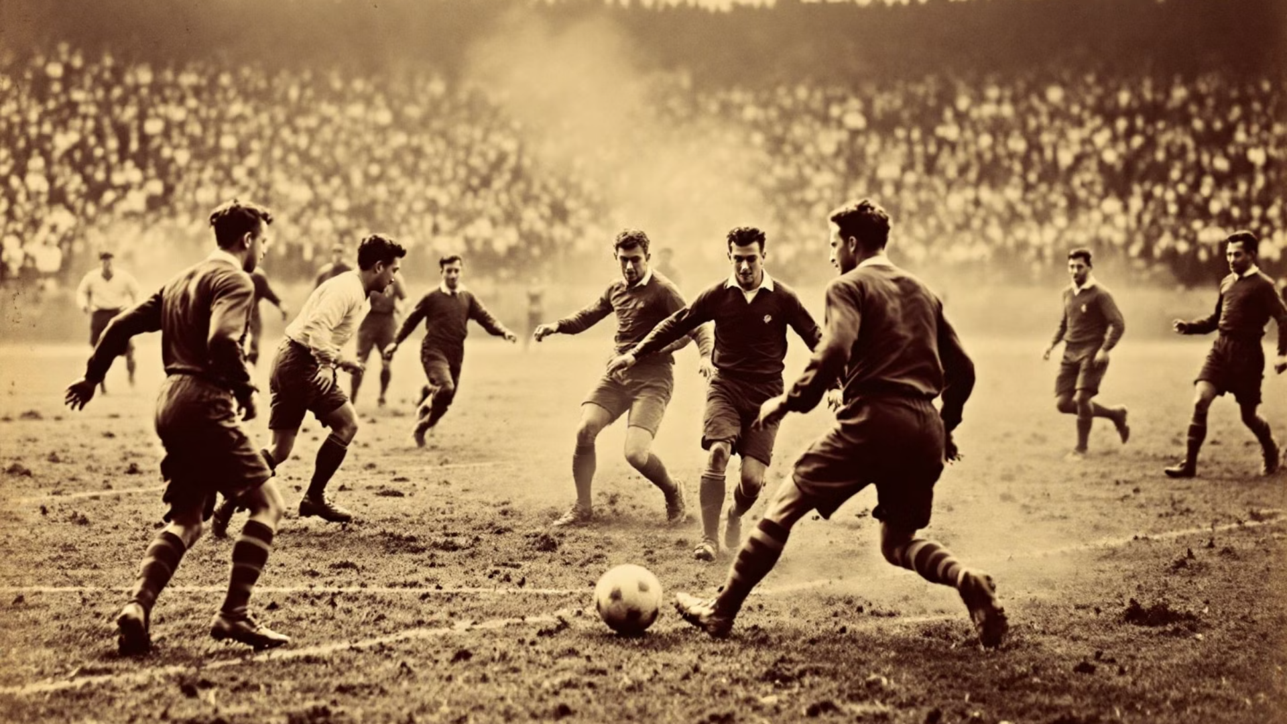
History of FIFA
1904
1
FIFA founded in Paris, France
2
1908
Football becomes an official Olympic competition
1914
3
FIFA recognizes Olympic tournament as world championship for amateurs
4
1920-1928
Uruguay wins two consecutive Olympic football tournaments

Slide 7

The First FIFA World Cup
Date
Location
July 18, 1930
Uruguay
Teams
Champion
13 teams from 3 confederations
Uruguay (Runners-up: Argentina)

Slide 8
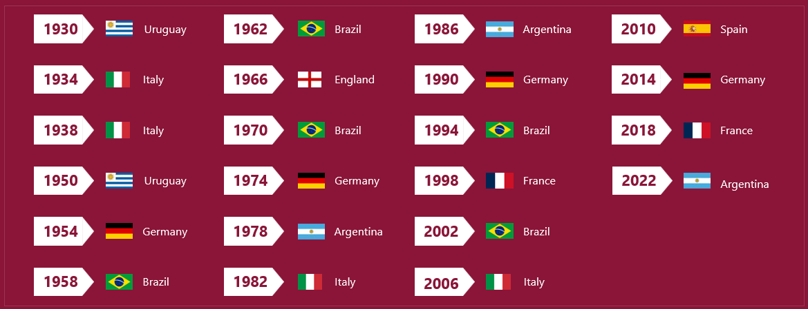
World Cup Winners So Far
1930 - 2022

Slide 9
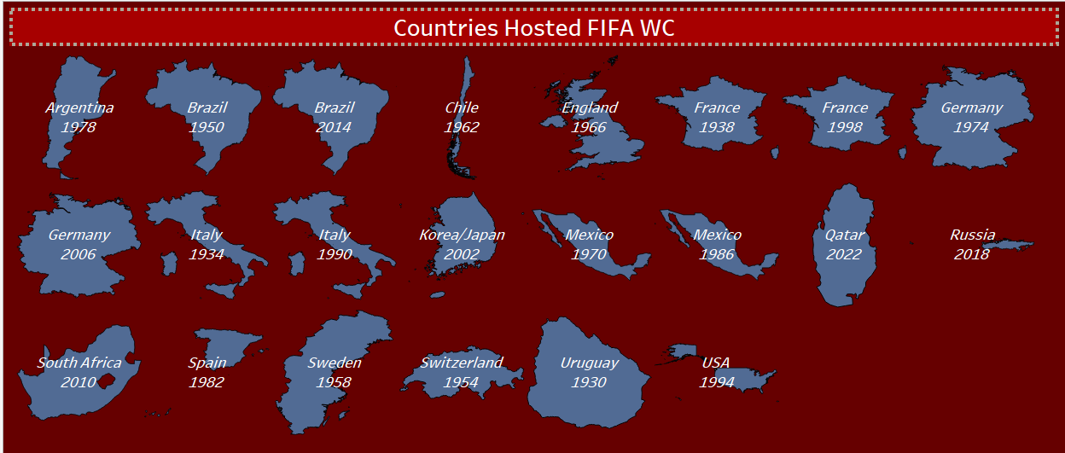
FIFA HOSTED BY DIFFERENT COUNTRIES

Slide 10
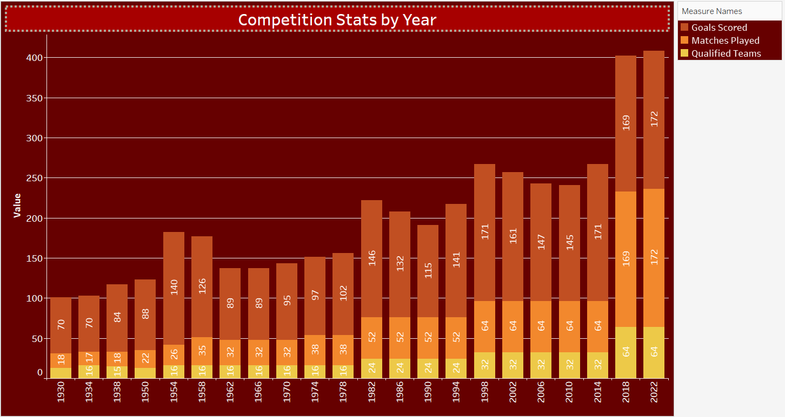
STATS OF FIFA WORLD CUP

Slide 11
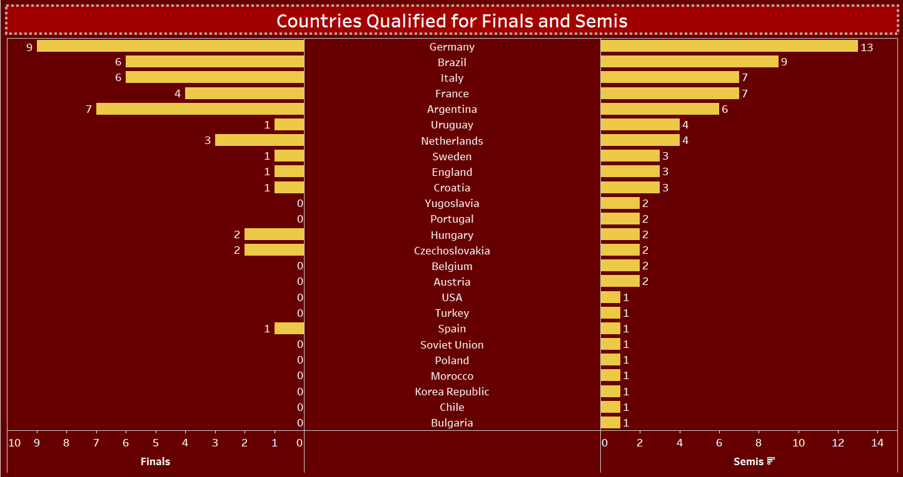

Slide 12

FIFA WC Award
Golden Boot Award
Top Goal Scorer of the tournament
Golden Ball Award
Outstanding player of the tournament
Golden Glove Award
Best goalkeeper of the tournament
Young Player Award
Best player under 21 years of age at the start of the calendar year

Slide 13
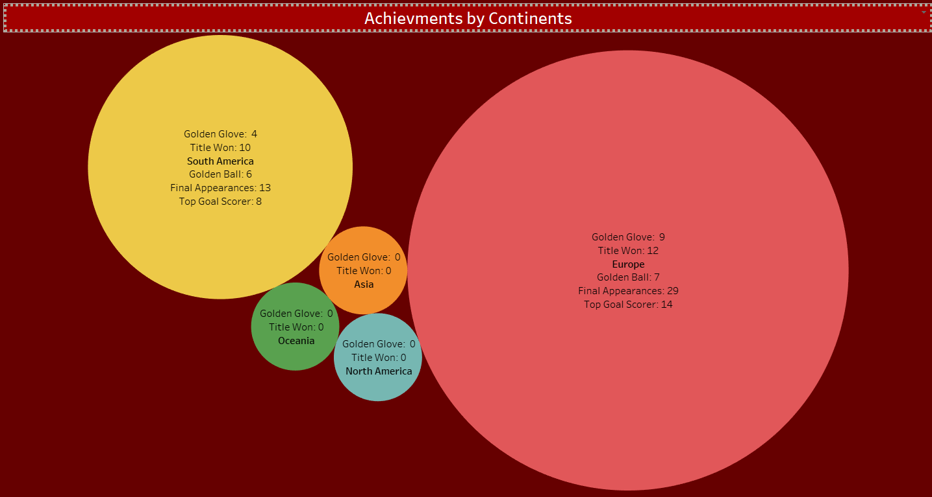

Slide 14

Is it a Two Continent sport?
Till now zero title won by any non-European or non-South American country
Not a single non-European or non-South American country has winning percentage more than 35% in International
None of the award in FIFA is featured by any non-European or non-South American country
Only sport in the world where over 200+ countries have obtained their international status. But only 0.04% countries able to win WC.

Slide 15

Reasons for Europe and South America's Dominance
Rich Football History
Better Infrastructure and Facilities
Competitive Domestic Leagues
Europe and South America have a long-standing football culture and history, with football being deeply ingrained in society.
Countries in these regions invest heavily in football infrastructure, providing world-class facilities for youth development and professional teams.
Both continents have some of the most competitive and financially lucrative domestic leagues in the world, attracting top talent.
Limited Access to Top-Level Coaching
Strong Football Institutions
Coaching standards in these regions often fall short of those in Europe and South America, limiting the development of talent.
Governance bodies like UEFA and CONMEBOL are highly organized, ensuring competitive integrity and strong developmental programs.

Slide 16

Reason behind Struggle
Infrastructure and Economic Instability
Limited International Matches
Lack of Infrastructure and Political and economic challenges in African and Asian Continents make it difficult to prioritize sports development
Teams from Asia, Africa, and Oceania often play fewer competitive international matches against top-ranked teams, limiting their exposure to football competition
Migration
Limited Access to Top-Level Coaching
Many talented players from Asia, Africa often migrate to Europe to play in more competitive leagues, further strengthening European dominance in global football.
Coaching standards in these regions often fall short of those in Europe and South America, limiting the development of talent.

Slide 17

The Future of the Football
Enhance Domestic Leagues
More Global Reach
Better Facilities and Infrastructure
Strengthen local leagues to increase competition, raise standards, and develop top-level players.
With more nations hosting and participating, the World Cup will reach new audiences, particularly in underrepresented regions.
Invest in better training facilities and football academies to develop top-tier talent. Focus on Scouting and Analytics
Expansion to 48 Teams (2026)
Increase International Exposure
The World Cup will expand to include 48 teams, allowing more nations to participate and increasing global representation.
Play more friendly matches against top-ranked teams to gain experience and improve performance.

Slide 18
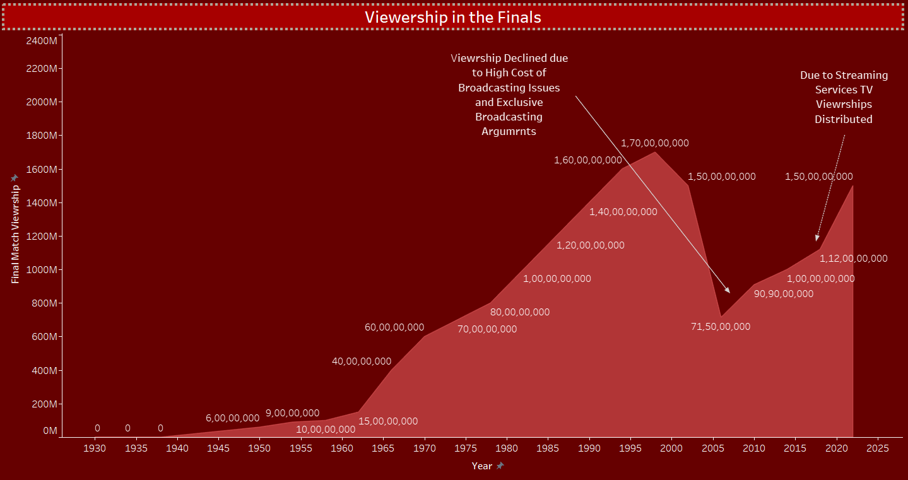
FIFA is hosting the upcoming World Cups in the USA, Morocco, and Saudi Arabia, expanding the tournament’s presence in North America, Africa, and Asia. This strategic move aims to engage a broader global audience and enhance regional participation.

Slide 19


